Slide 1

Increasing Hire Heroes Donors by Geographic Locations and Social Media
By: Heran, Farres, Jonathan, Samuel, Zeeshan

Slide 2
Overview
Is there a geographic location within the US that most of our individual donors come from? Are there areas in the country we don't see any donors from? Do our social media posts or fundraisers calling for donations hit these areas with little to no donors?

Slide 3
Problem and Motivation
Why is this a problem and why is finding a donors per state significant
We believe that looking into the geographic and social media/fundraising data can help Hire Heroes USA use their marketing budget more efficiently and get significantly more donations
Hire Heroes spent $368,936 on Fundraising, only $6,953 of it went to Marketing
We focused on Hire hero members and not total population of state
The data was primarily on Hire Hero members so there was not enough data to focus on the total state population
The members know what Hire Heroes is and align with their goals and mission, so they are more likely to donate

Slide 4
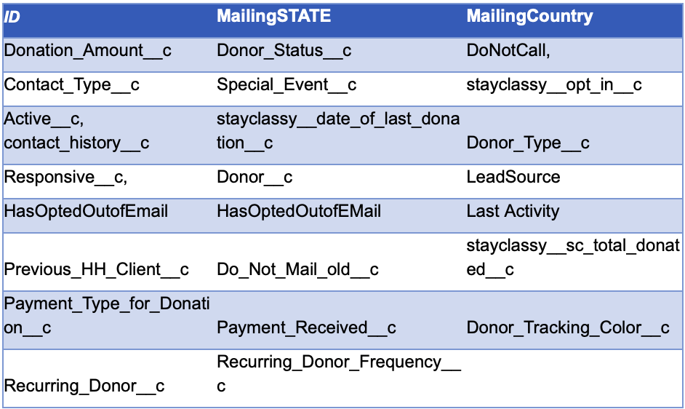
Approach
Focal point: increasing donations in low donating states/territories
Utilized Contact_Data.xls in order to solve the problem at hand
Cross referenced all the column headings with the Data Dictionary
After reviewing the document we narrowed it down to 23 columns we deemed necessary in our analysis
Utilizing various data mining software to create diagrams and figures.

Slide 5
Cleaning the Data
Converted the Contact_Data.csv file into an Excel readable format
Analyzed the “MailingState” column to make sure all the states/ territories were in their abbreviated format.
Noticed anomalies such as blank abbreviations or any other states/abbreviations that were not within the US after plugging the data into Tableau Prep
Inputted the data into tableau desktop , we used the geographic feature and for some of the data it showed locations outside the US, so we decided to remove them from our file.

Slide 6
Tools and Analytics
Utilized Excel
Conversion of CSV files into Excel
Fixed MailingState Column Abbreviations
Removed Anomalies that were not states in the US
Utilized Tableau Prep
Plugged Excel File into Tableau
Removed unnecessary data
Created geographic maps & tables
Utilized Tableau Desktop
Converted MailingState and MailingCountry into geographic fields
Converted Donor_C from Dimension to Measure
Created a mapping hierarchy
Tier 1 MailingCountry
Tier 2 MailingState

Slide 7
Results
Most donors came from Georgia (620 Donors)
Percentages are more accurate than number of donors
Average Percentage of Donors per State Model:
Sum of Percentages / Number of States and Territories
Each state should have a target of 5.3%
Only 14 states are meeting this target currently
By implementing this model, Hire Heroes will increase their total donors by 16% or in other words, 1,046 donors.

Slide 8
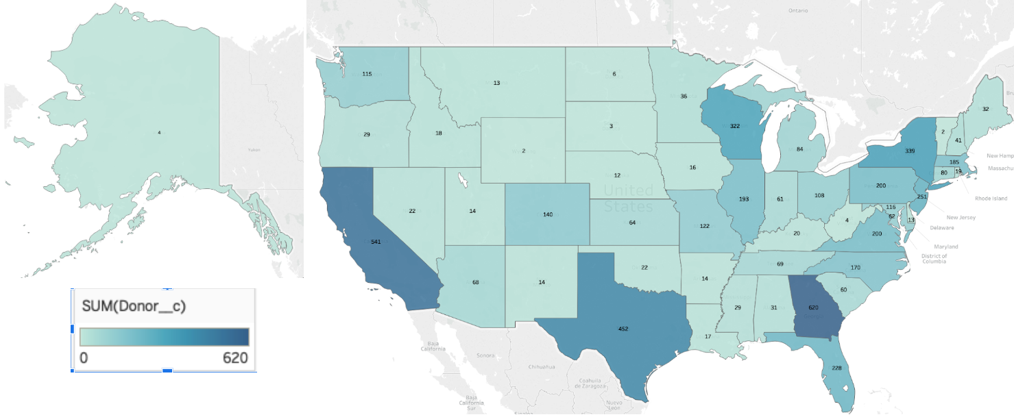
Donors Per State

Slide 9
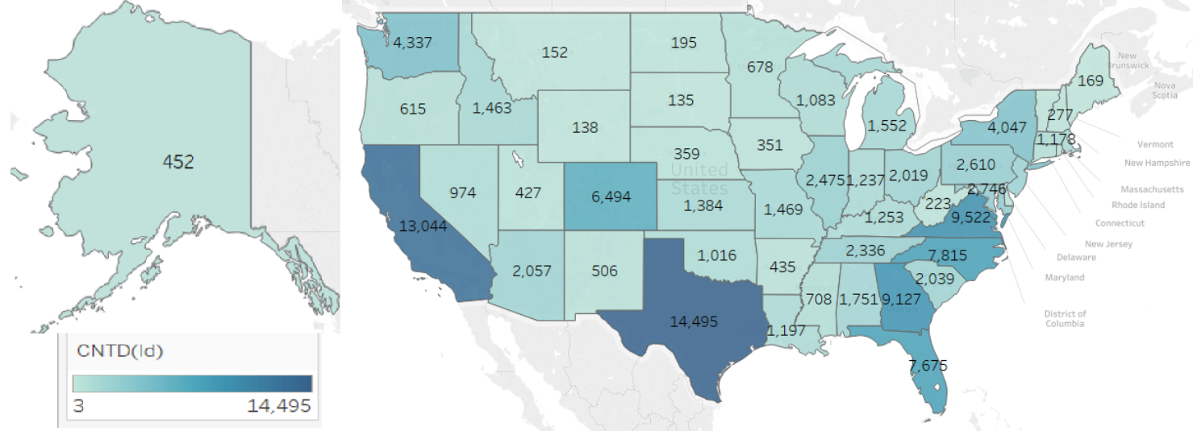
Members Per State

Slide 10
Recommendations
Our recommendation is that states that are not meeting the 5.3% average should be the target of Hire Heroes social media campaign
Our recommendation is for Hire Heroes to update their social media presence
Our recommendations acknowledge that the presentation of this data may be flawed
‘Response_C’ column - The ‘0’ could mean two things:
Contacted but not responded
Not contacted at all
Notes:
Mention these (these are in order by bullet points):
The reason for those states being targeted is because states that are above the recommended percent have an active member base and are involved with the campaign (Bullet 1)
According to Response columns, The only ‘social media’ they are using is call, fax, and email (Bullet 2)
They should update social media to texts, facebook, instagram, etc to appeal to younger generations (Bullet 2)
According to the data presented, Hire Heroes is reaching out to every member. Explain why this is wrong (Bullet 3)

